Slide 1
Physically Based Rendering From Theory to Implementation
Chapter 13 : Monte Carlo Integration I – Basic Concepts
Metropolis Sampling
Basic Algorithm
Choosing Mutation Strategies
Start-up Bias
Estimating Integrals with Metropolis Sampling
Transforming between Distributions
Transformation in Multiple Dimensions
2D Sampling with Multi-dimensional Transformations
옥찬호 (utilForever@gmail.com)

Slide 2
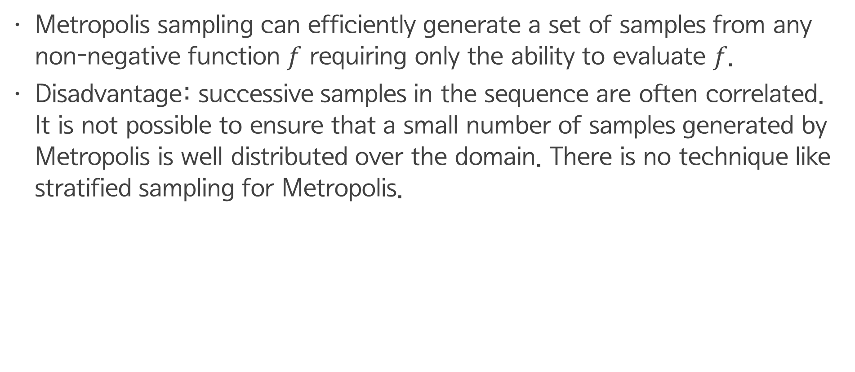
Metropolis Sampling
Metropolis sampling can efficiently generate a set of samples from any non-negative function $f$ requiring only the ability to evaluate $f$.
Disadvantage: successive samples in the sequence are often correlated. It is not possible to ensure that a small number of samples generated by Metropolis is well distributed over the domain. There is no technique like stratified sampling for Metropolis.

Slide 3




Metropolis Sampling
Problem: given an arbitrary function assuming generate a set of samples
$$f\left(x\right)→ℝ, x∈Ω$$
$$I\left(f\right)=\int_{Ω}{f\left(x\right)dΩ}$$
$$f_{pdf}=f/I(f)$$
$$X=\left\{x_{i}\right\}, x_{i} \sim f_{pdf}$$

Slide 4
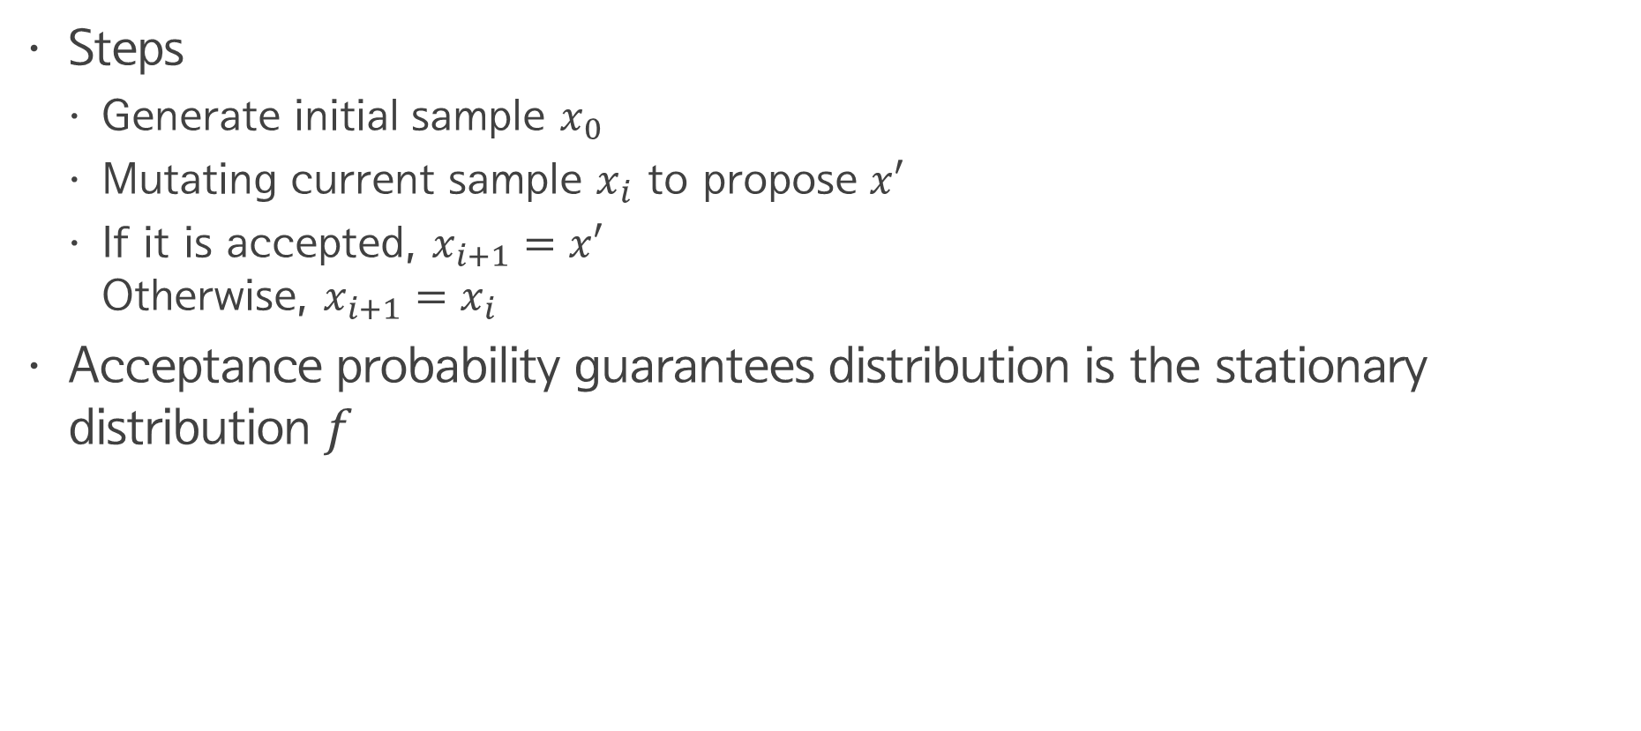
Metropolis Sampling
Steps
Generate initial sample $x_{0}$
Mutating current sample $x_{i}$ to propose $x′$
If it is accepted, $x_{i+1}=x′$ Otherwise, $x_{i+1}=x_{i}$
Acceptance probability guarantees distribution is the stationary distribution $f$

Slide 5
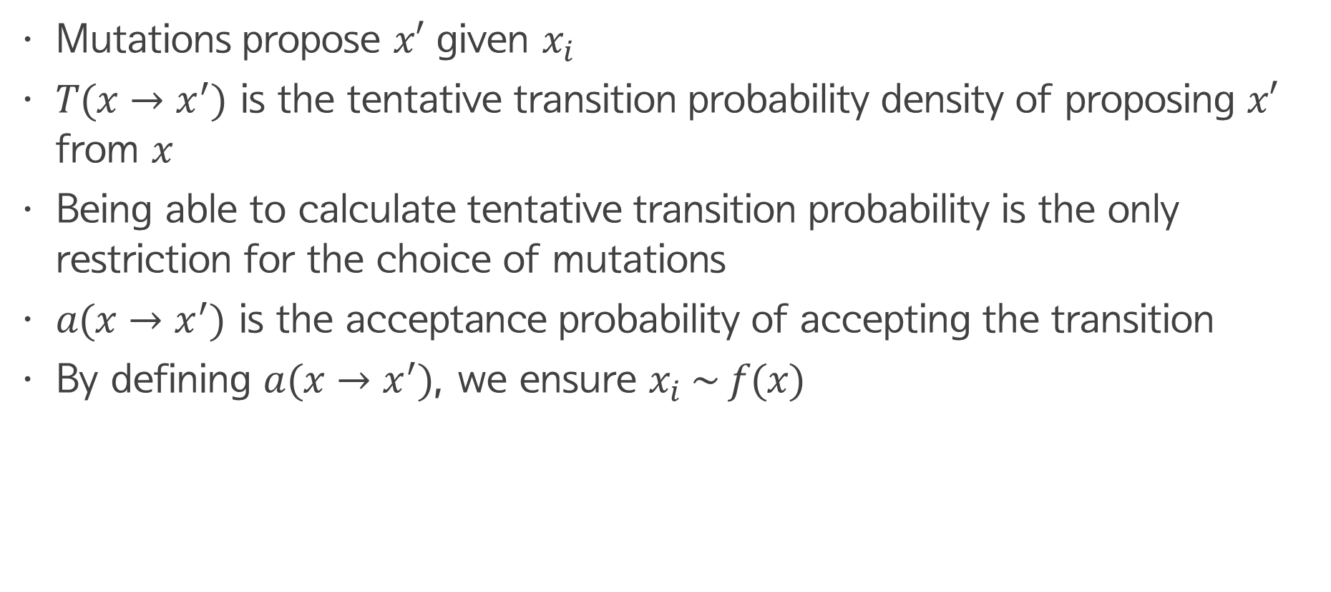
Metropolis Sampling
Mutations propose $x′$ given $x_{i}$
$T(x→x^{′})$ is the tentative transition probability density of proposing $x′$ from $x$
Being able to calculate tentative transition probability is the only restriction for the choice of mutations
$a(x→x^{′})$ is the acceptance probability of accepting the transition
By defining $a(x→x^{′})$, we ensure $x_{i} \sim f(x)$

Slide 6
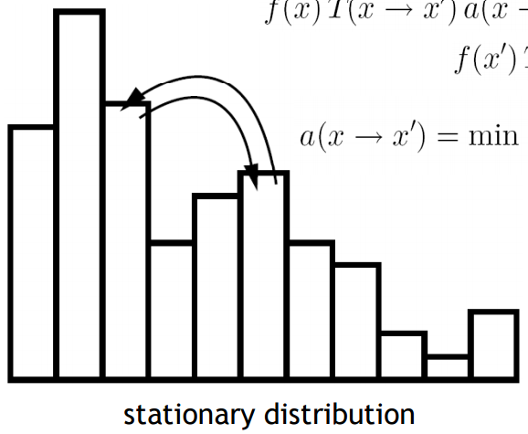
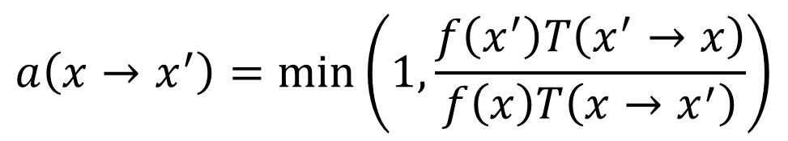
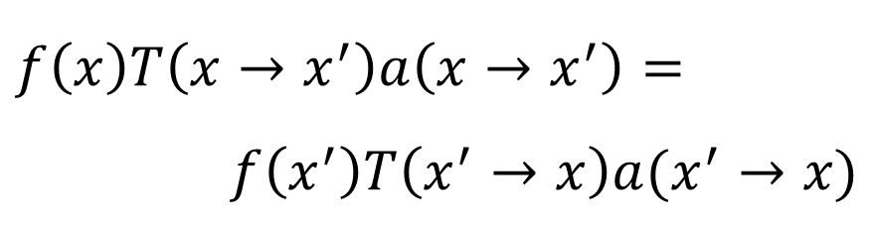
Metropolis Sampling
Detailed balance
$$f\left(x\right)T\left(x→x^{′}\right)a\left(x→x^{′}\right)=$$
$$f\left(x^{′}\right)T\left(x^{′}→x\right)a(x^{′}→x)$$
$$a\left(x→x^{′}\right)=\min_{}\left(1, \frac{f\left(x^{′}\right)T\left(x^{′}→x\right)}{f\left(x\right)T\left(x→x^{′}\right)}\right)$$

Slide 7
Pesudo Code
x = x0
for i = 1 to n
x’ = mutate(x)
a = accept(x, x’)
if (random() < a)
x = x’
record(x)

Slide 8
Pesudo Code (Expected Value)
x = x0
for i = 1 to n
x’ = mutate(x)
a = accept(x, x’)
record(x, (1-a) * weight)
record(x’, a * weight)
if (random() < a)
x = x’

Slide 9


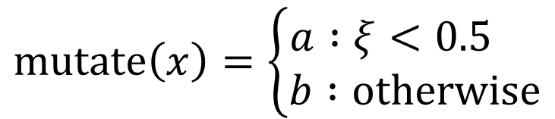
Binary Example I
$Ω=a, b$ and $f\left(a\right)=9$, $f\left(b\right)=1$
Then transition densities are
It directly follows that
$$mutate\left(x\right)=\left\{\begin{aligned}a :ξ<0.5 \\ b :otherwise\end{aligned}\right.$$
$$T\left(\left\{a, b\right\}→\left\{a, b\right\}\right)=1/2$$
$$a\left(a→b\right)=\min\left(1, {f\left(b\right)}/{f\left(a\right)}\right)=.1111…$$
$$a\left(a→a\right)=a\left(b→a\right)=a\left(b→b\right)=1$$

Slide 10

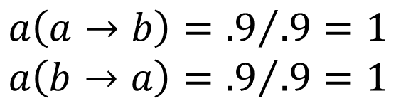
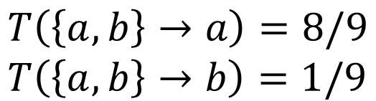
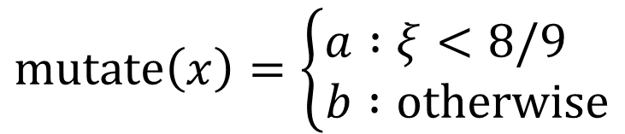
Binary Example I
$Ω=a, b$ and $f\left(a\right)=9$, $f\left(b\right)=1$
Transition densities
Acceptance probabilities
Better transitions improve acceptance probability!
$$mutate\left(x\right)=\left\{\begin{aligned}a :ξ<8/9 \\ b :otherwise\end{aligned}\right.$$
$$T\left(\left\{a, b\right\}→a\right)=8/9 \\ T\left(\left\{a, b\right\}→b\right)=1/9$$
$$a\left(a→b\right)={.9}/{.9}=1 \\ a\left(b→a\right)={.9}/{.9}=1$$

Slide 11
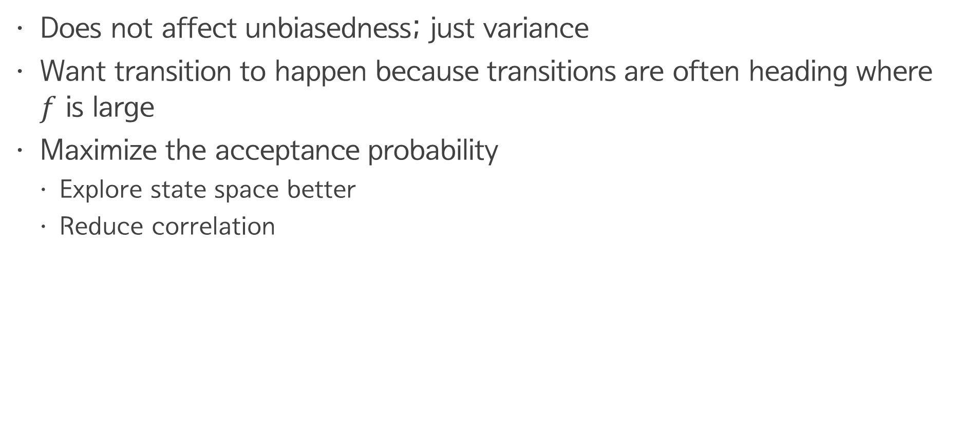
Acceptance Probability
Does not affect unbiasedness; just variance
Want transition to happen because transitions are often heading where $f$ is large
Maximize the acceptance probability
Explore state space better
Reduce correlation

Slide 12
Mutation strategy
Very free and flexible; the only requirement is to be able to calculate transition probability
Based on applications and experience
The more mutation, the better
Relative frequency of them is not so important

Slide 13
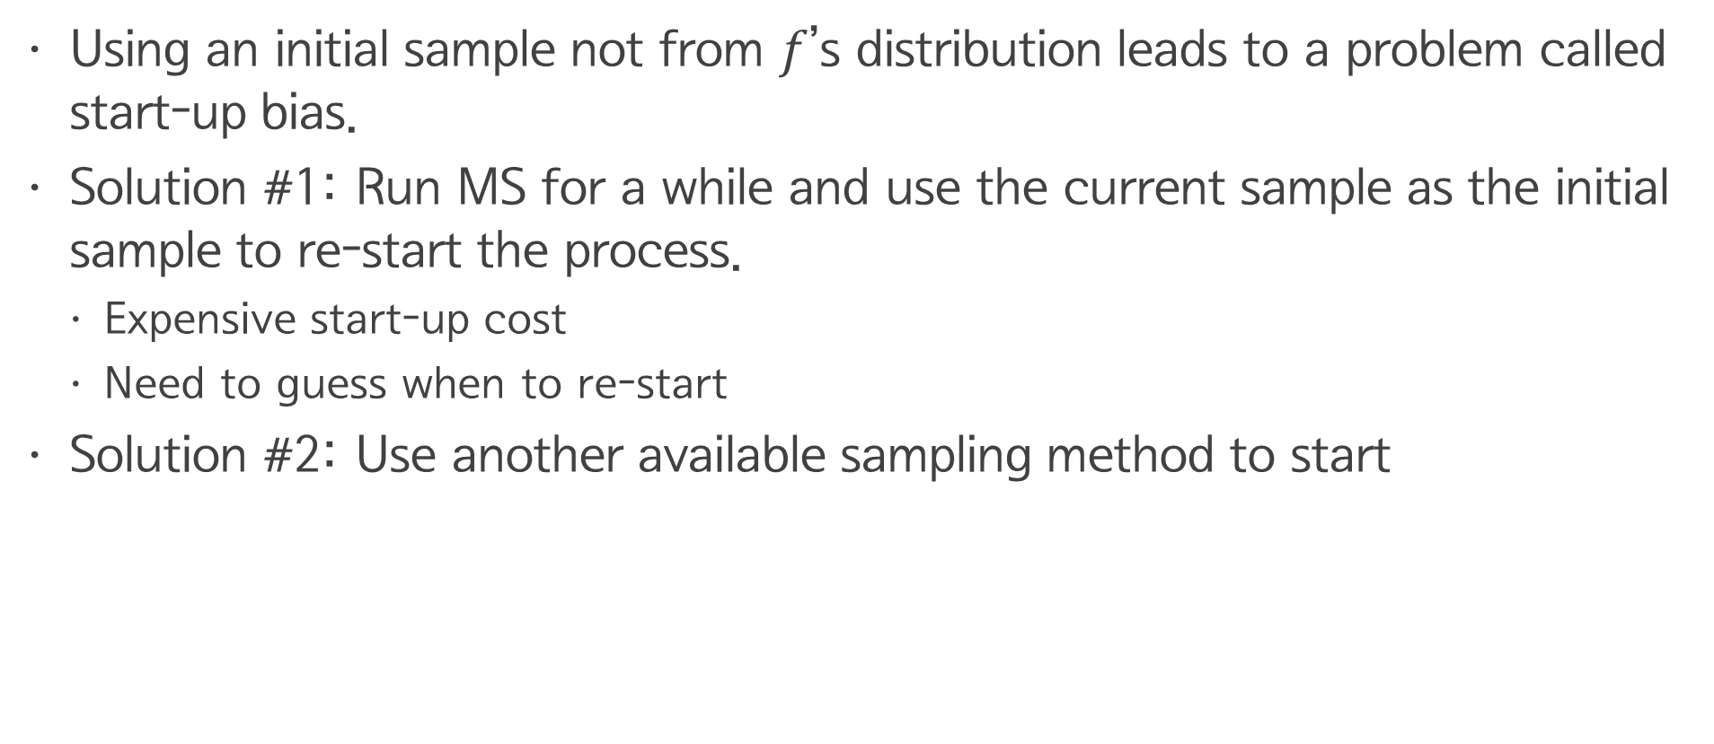
Start-up Bias
Using an initial sample not from $f$’s distribution leads to a problem called start-up bias.
Solution #1: Run MS for a while and use the current sample as the initial sample to re-start the process.
Expensive start-up cost
Need to guess when to re-start
Solution #2: Use another available sampling method to start

Slide 14

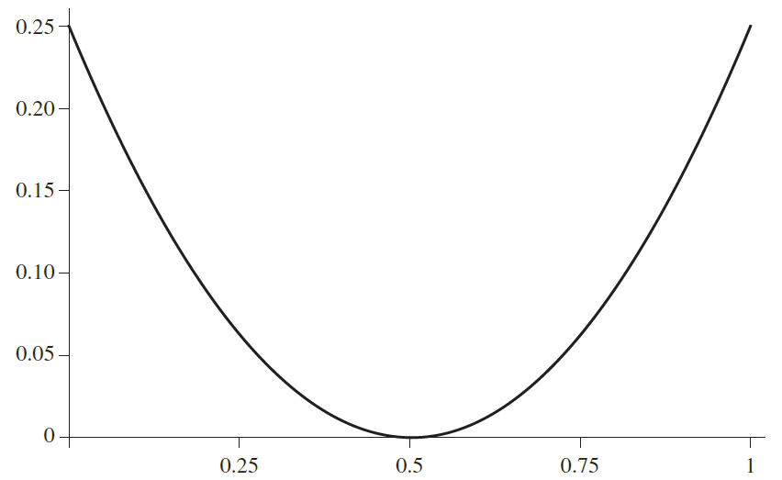
1D Example

Slide 15

1D Example
$mutate_{1}\left(x\right)→ξ$
$T_{1}\left(x→x^{′}\right)=1$
$mutate_{2}\left(x\right)→x+.1∗(ξ−.5)$
$T_{2}\left(x→x^{′}\right)=\left\{\begin{aligned}\frac{1}{0.1} :\left|x−x^{′}\right|≤.05 \\ 0 :otherwise \end{aligned}\right.$

Slide 16
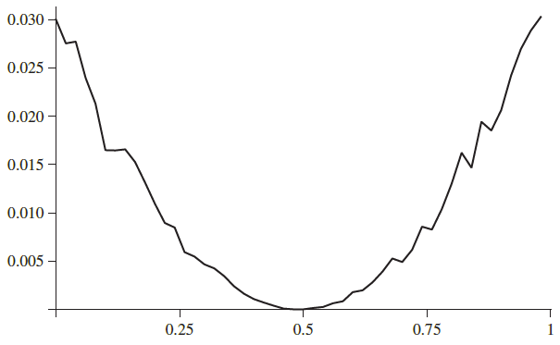
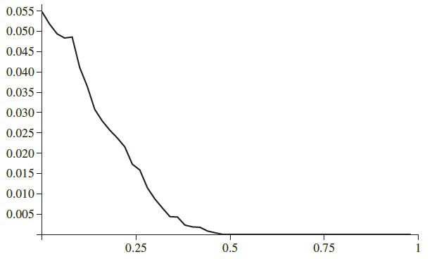
1D Example
Mutation 1
Mutation 2 10,000 Iterations

Slide 17
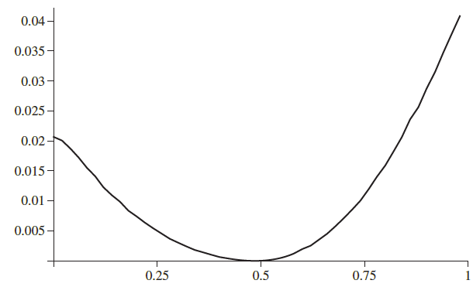
1D Example
Mutation 1
Mutation 2 300,000 Iterations

Slide 18
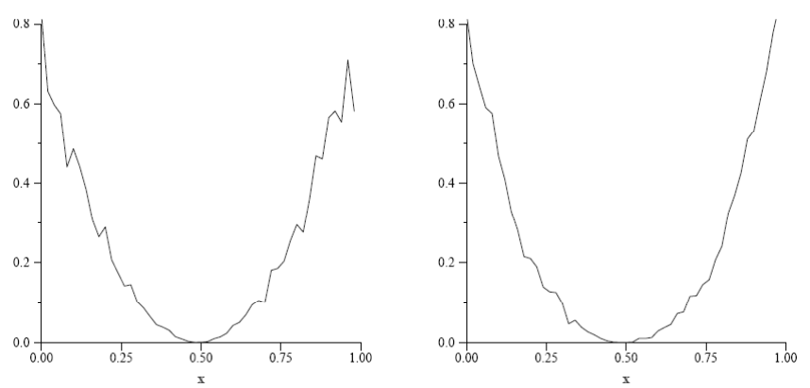
1D Example
Mutation 1
90% Mutation 2 + 10% Mutation 1
Periodically using uniform mutations increases ergodicity

Slide 19
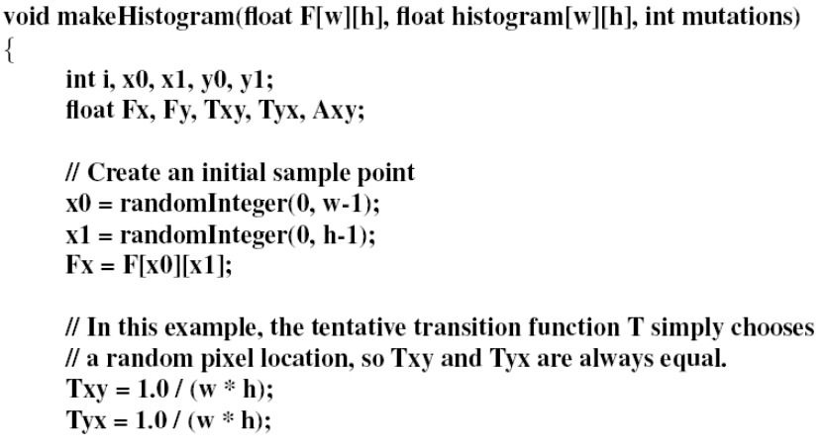
2D Example

Slide 20
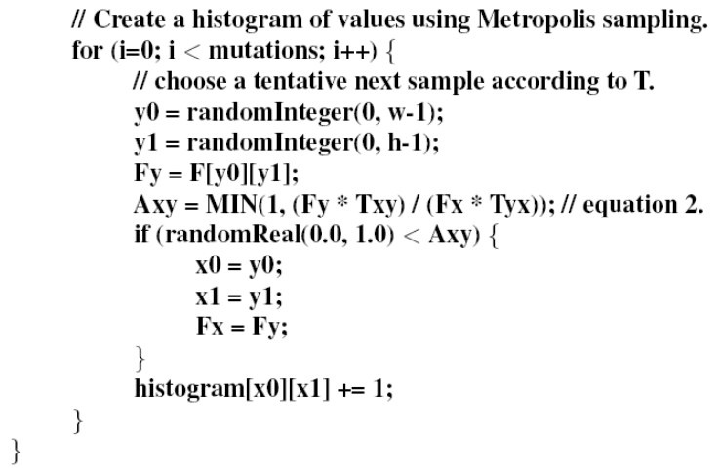
2D Example

Slide 21
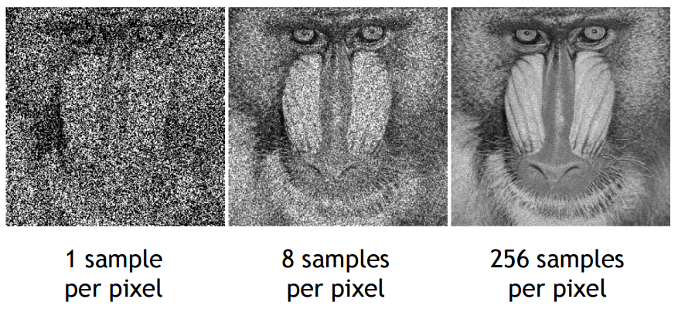
2D Example

Slide 22
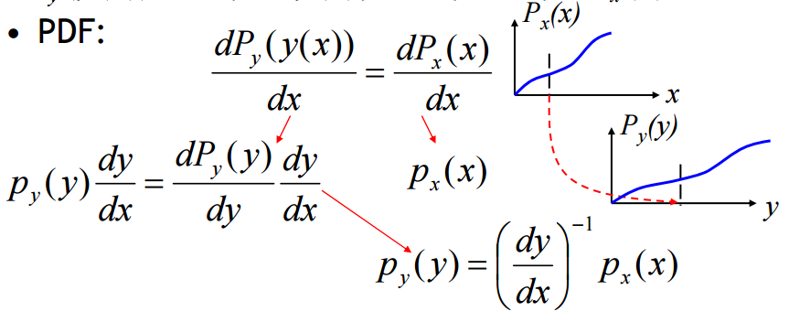

Transformation of Variables
Given a random variable $X$ from distribution $p_{x}(x)$ to a random variable $Y=y(X)$, where $y$ is one-to-one, i.e. monotonic. We want to derive the distribution of $Y$, $p_{y}(y)$.
$P_{y}\left(y\left(x\right)\right)=Pr\left\{Y≤y\left(x\right)\right\}=Pr\left\{X≤x\right\}=P_{x}(x)$
PDF:

Slide 23

Example
$p_{x}\left(x\right)=2x$
$Y=\sin{X}$
$$p_{y}\left(y\right)={\left(\cos{x}\right)}^{−1}p_{x}\left(x\right)=\frac{2x}{\cos{x}}=\frac{2\sin^{−1}{y}}{\sqrt{1−y^{2}}}$$

Slide 24
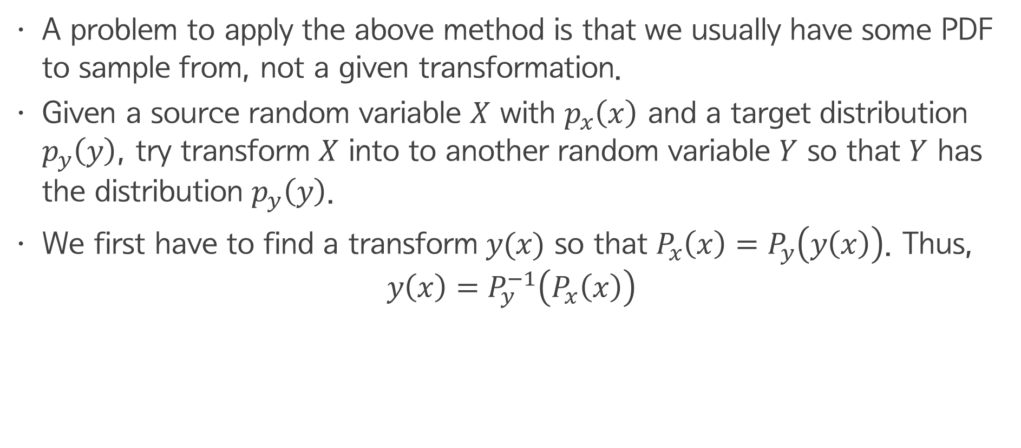
Transformation Method
A problem to apply the above method is that we usually have some PDF to sample from, not a given transformation.
Given a source random variable $X$ with $p_{x}\left(x\right)$ and a target distribution $p_{y}\left(y\right)$, try transform $X$ into to another random variable $Y$ so that $Y$ has the distribution $p_{y}\left(y\right)$.
We first have to find a transform $y(x)$ so that $P_{x}\left(x\right)=P_{y}\left(y\left(x\right)\right)$. Thus,
$$y\left(x\right)=P_{y}^{−1}\left(P_{x}\left(x\right)\right)$$

Slide 25
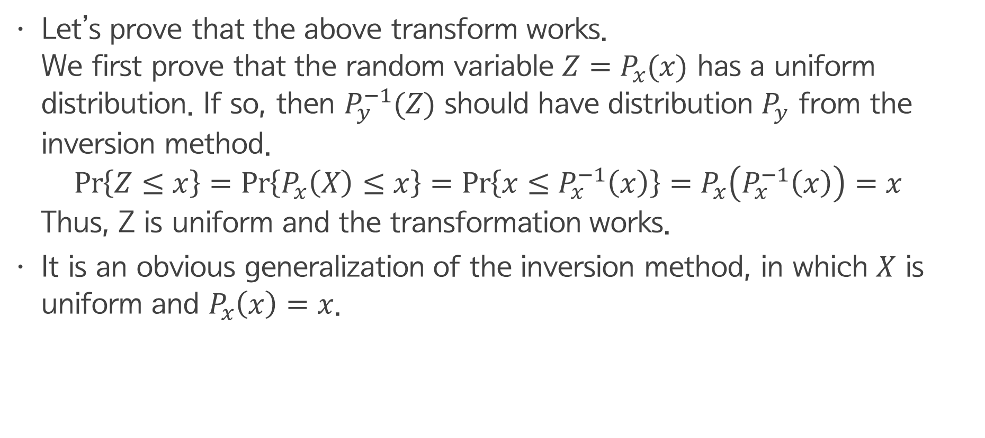
Transformation Method
Let’s prove that the above transform works. We first prove that the random variable $Z=P_{x}(x)$ has a uniform distribution. If so, then $P_{y}^{−1}(Z)$ should have distribution $P_{y}$ from the inversion method. $\operatorname{Pr}\left\{Z≤x\right\}=\operatorname{Pr}\left\{P_{x}\left(X\right)≤x\right\}=\operatorname{Pr}\left\{x≤P_{x}^{−1}\left(x\right)\right\}=P_{x}\left(P_{x}^{−1}\left(x\right)\right)=x$ Thus, Z is uniform and the transformation works.
It is an obvious generalization of the inversion method, in which $X$ is uniform and $P_{x}\left(x\right)=x$.

